Slide 1
Brightness Uniformer

Slide 2
Goal
Even out illumination intensities between tiles for a more seamless appearance
Previous attempts have resulted in strange results. Sometimes it was ok, sometimes tiles had massive values. I suspect I was propagating valves through and I was adding in ratios in the equation with denominators that were near zero (thus near infinity results)
New version will explicitly track if tiles have been executed and rely on the new cluster filtered tissue image as an overlay to determine if an overlapped region has tissue or not. I do not care to match edges that don’t possess tissue. In addition, I only want to match intensities based on tissue signal

Slide 3
Primary array
Primary feature of this is the brightness array. It’s an numpy array that contains key info about the overlapped regions, what cycle the tile was registered under and the final ratio. Dimensions (y tiles, x tiles, 6)
Y tiles by X tiles Array
[North Overlap, South Overlap, East Overlap, West Overlap, Tile cycle Registration Number, Multiplication Ratio]

Slide 4
Workflow
Identify starting tile
Identify top most tissue containing row
Identify left (western) most tissue containing tile
Find the 1 or 2 tiles that touch the starting tile
Find ratio between tissue masked overlapped region (starting/border tile)
Register border tile as cycle 2 and propagate the ratio throughout its overlap region values
Identify all border tiles that tissue region overlap with previous cycle tiles
Filter out any that have been registered previously
Find ratio between tissue masked overlapped region (previous cycle tile/border tile). For ones that share more than one overlap region with other tiles, a flat average is taken of the resulting overlap region ratios
Repeat steps 5-7 until all tiles have been registered.

Slide 5
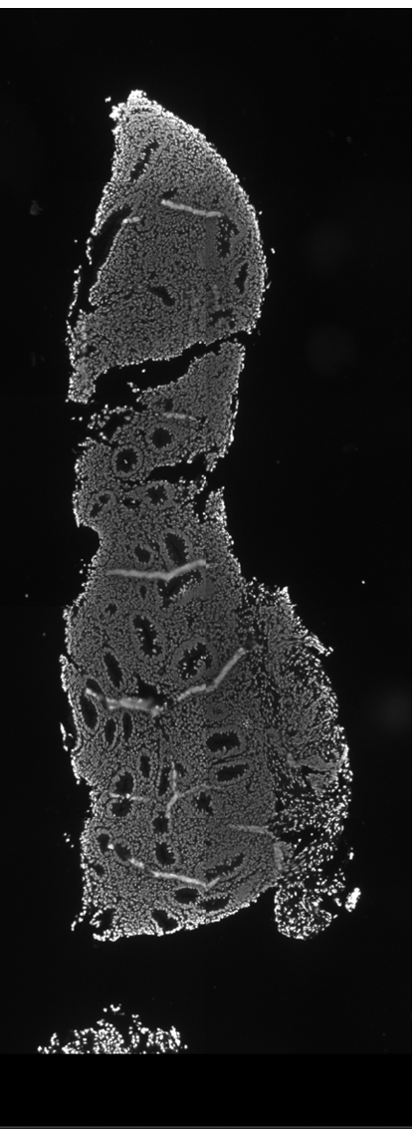
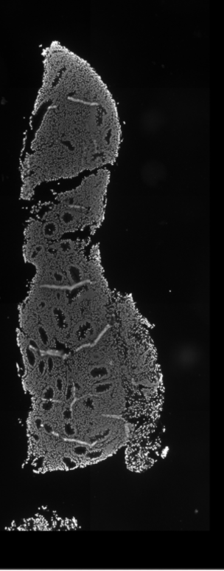
DAPI
After
Before

Slide 6
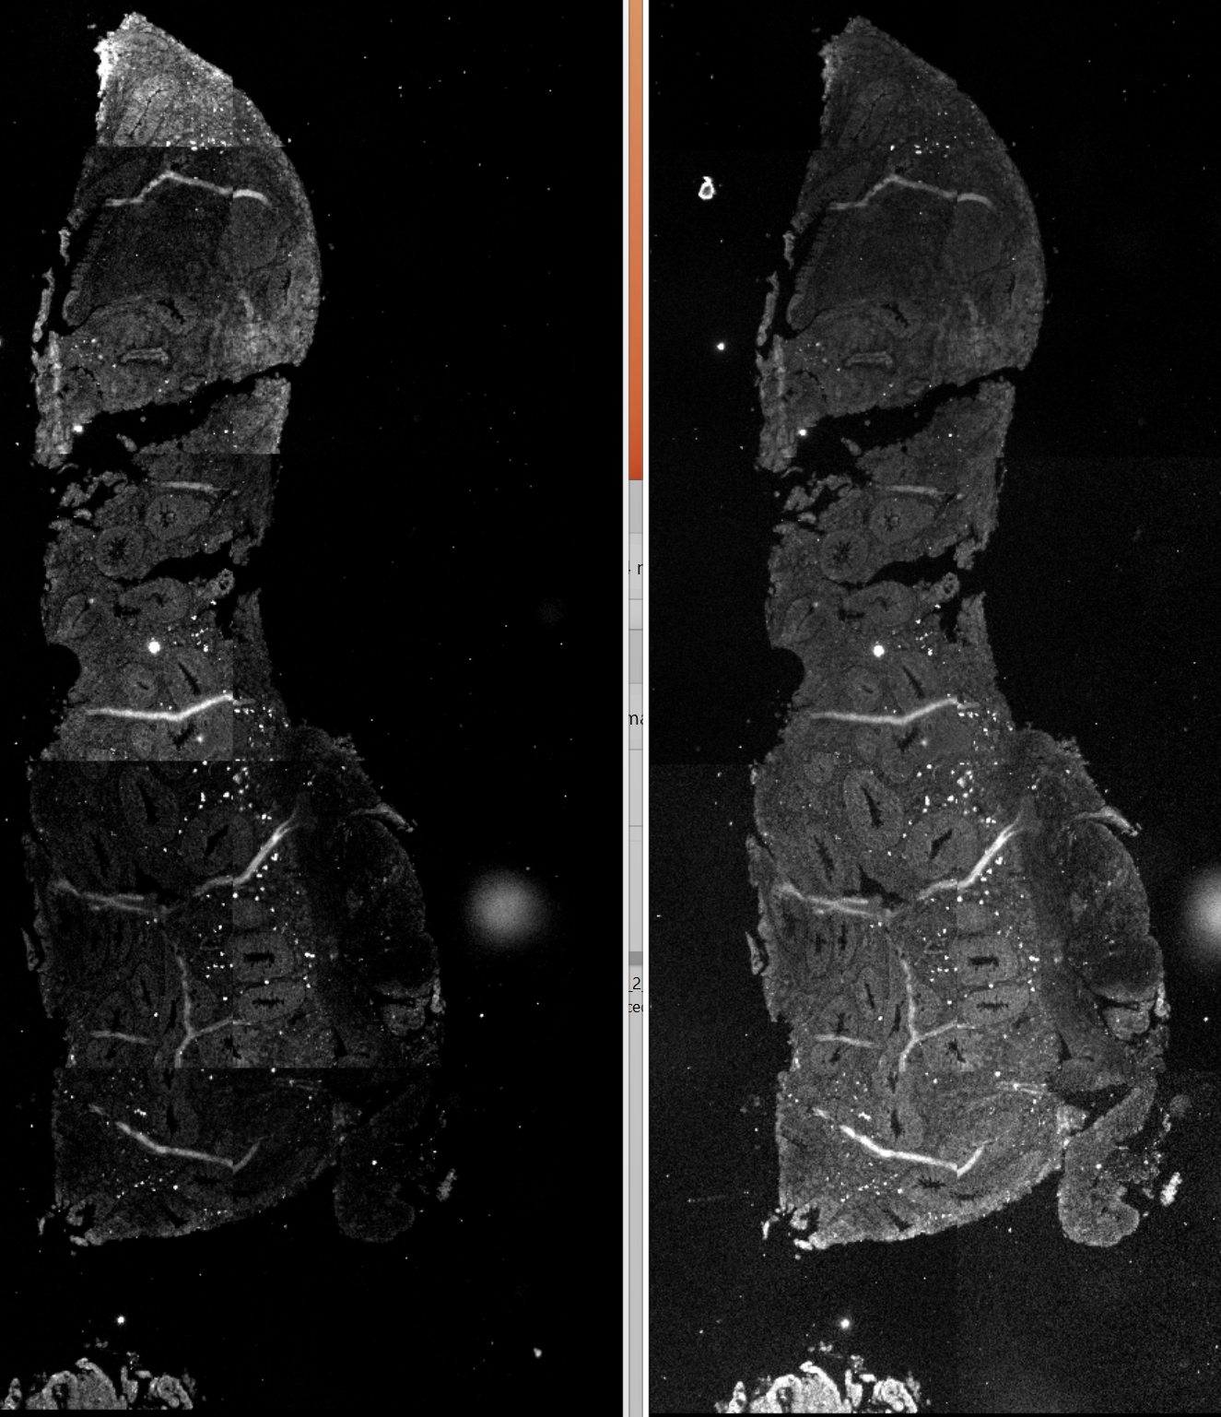
Before
After
A647

